Slide 1
Residential Email Retention Performance July 2016-Jan 2017

Slide 2
Overview
Tested two offers:
4% two year renewal
10% two year renewal offer
Targeted 5 InfoPro companies
Little Rock AR (858): 6,290
New Jersey (865): 8,457
Minnesota:
894: 5, 282
899: 4,207
923: 5,411
Removed customers less than 18 months, unprofitable
Research question(s):
Does the group that received a renewal offer have higher customer and revenue retention than a similar group who did not receive the offer?
Does the impact differ by customer tenure, revenue, InfoPro division or offer?

Slide 3
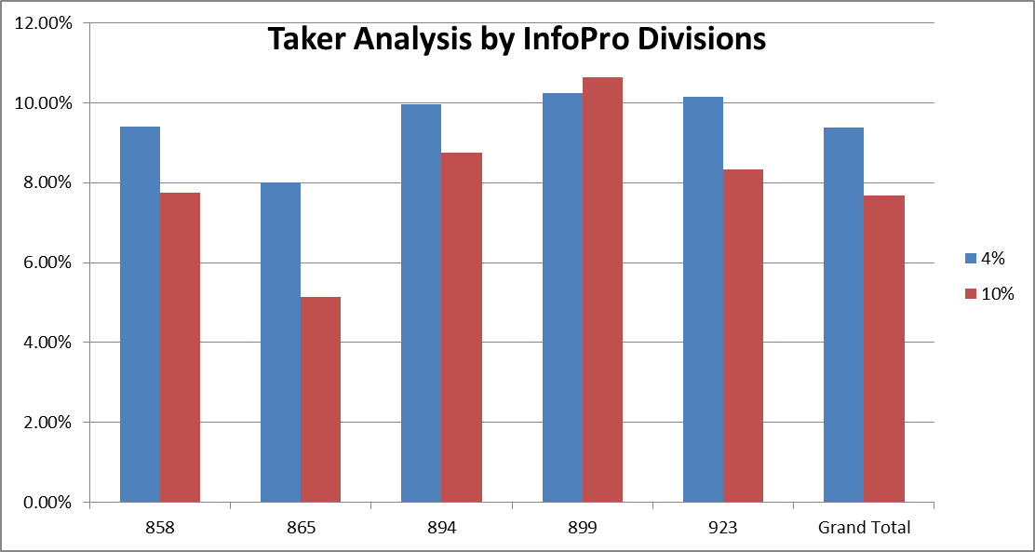
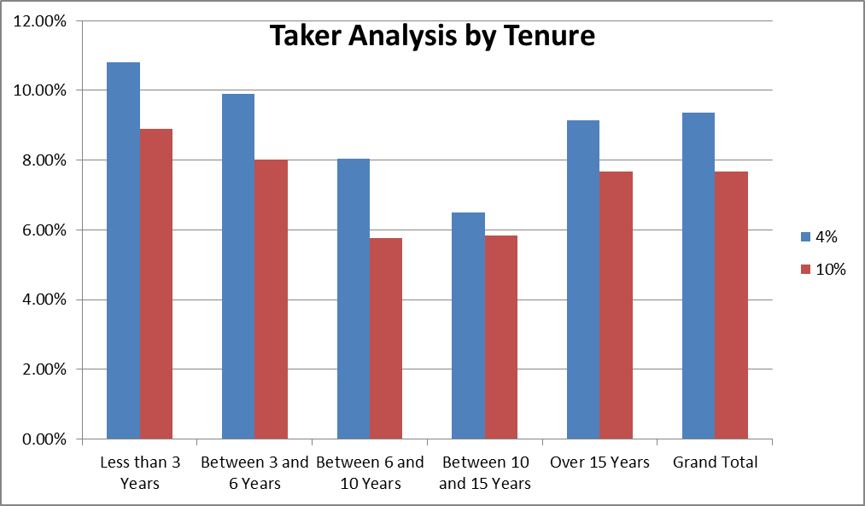
Take Rate Analysis (Takers vs Customers Emailed)
In most divisions the more aggressive 4% PI had a higher take rate than the 10% PI
865 showed the largest lift in take rates for the 4% offer relative to the 10% offer
899 showed a relatively high take rate that did not seem to depend on offer
Customers with less than 6 years of tenure had the highest take rates
Customers with over 15 years of tenure had average take rates
Customers with 6-15 years of tenure had below average take rates

Slide 4
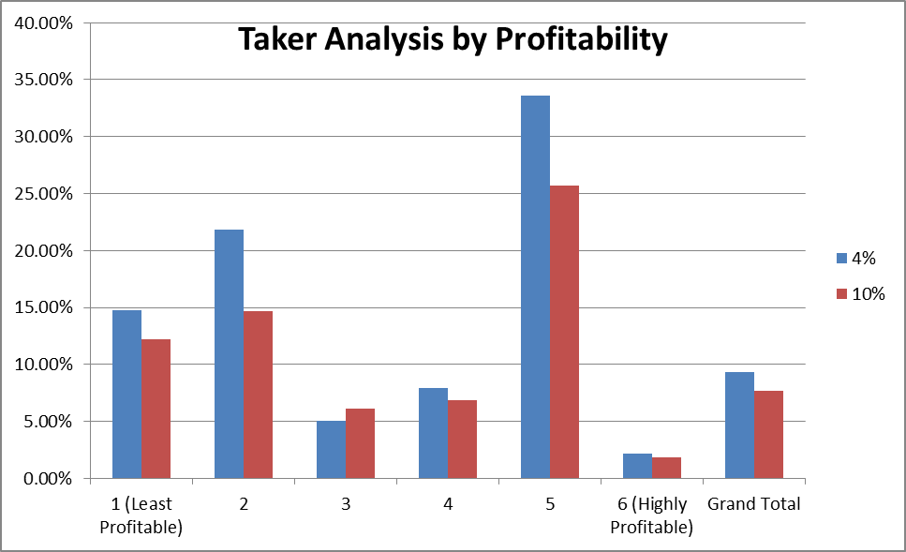
Take Rate Analysis (Takers vs Customers Emailed)
Group 5 had the highest take rate: 1.25 time to 2 times the division average.
Second highest take rate was from two least profitable groups

Slide 5
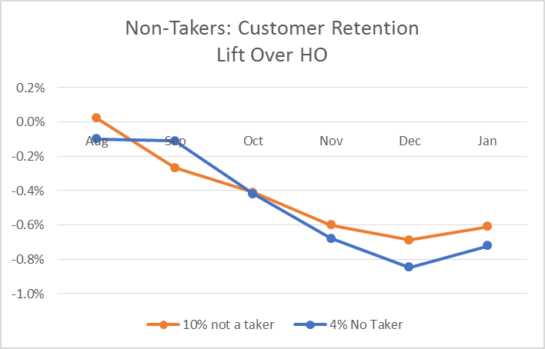
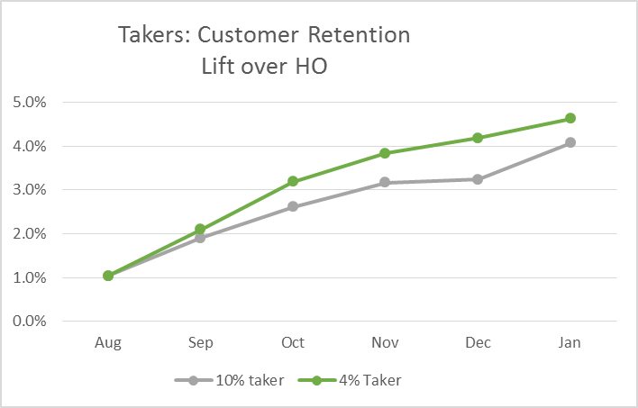
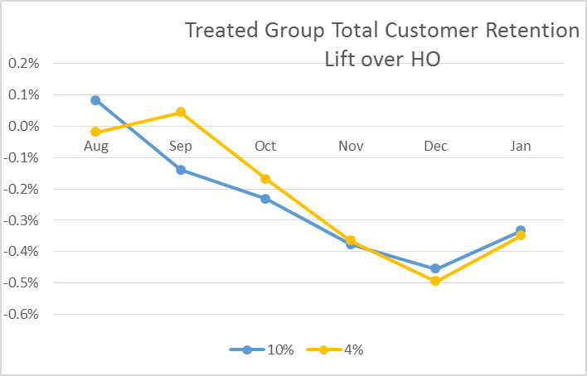
Customer Retention by Offer
No improvement in treated group relative to holdout observed
Selection bias observed between takers and non-takers
Overall impact slightly negative

Slide 6
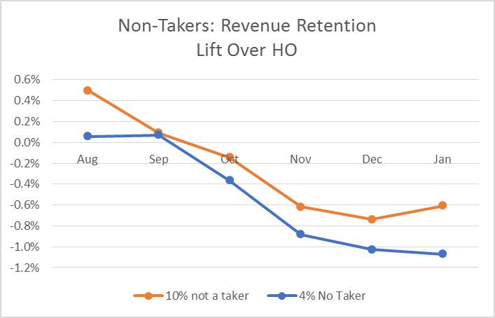
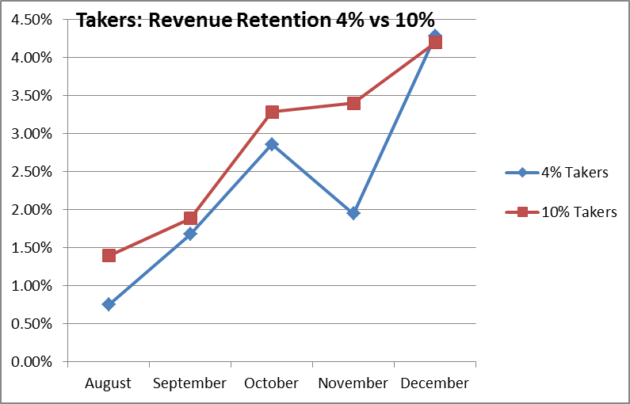
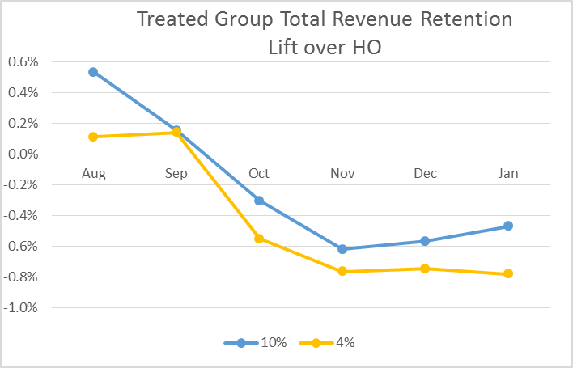
Revenue Retention by Offer
Takeaway:
Revenue lift negative for both 4% and 10% treated groups.
10% offer performs slightly better than 4% offer

Slide 7
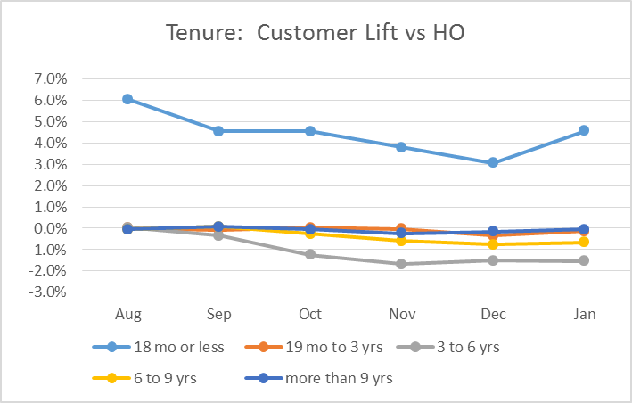
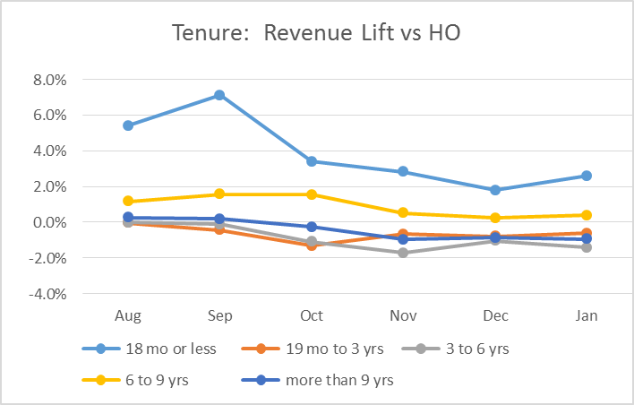
Tenure Impacts
New customers have positive customer retention lift
New customers and 6-9 yrs have positive revenue retention lift
Customer lift on 6-9yrs not significantly different from zero
New customer group very small, needs more testing
Oldest customers show no impact
Three to six year customers show negative revenue retention

Slide 8
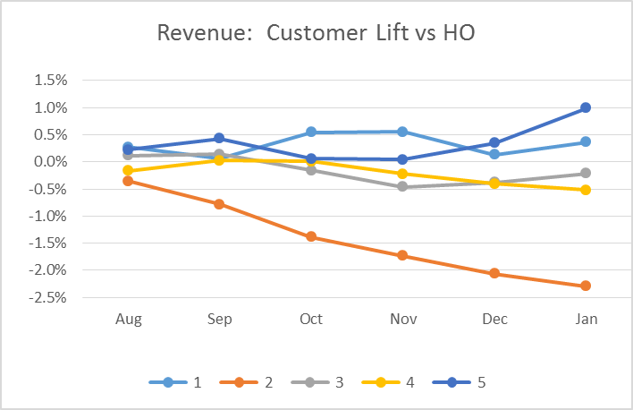
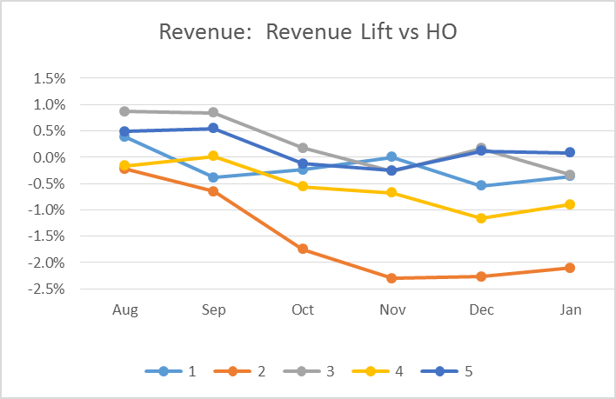
Revenue Group Impacts
Customer and revenue lift performed worst for 20-40 percentile of customers by revenue (second lowest revenue group
Customer lift was highest in the highest revenue group
Revenue lift slightly positive for the highest revenue group

Slide 9
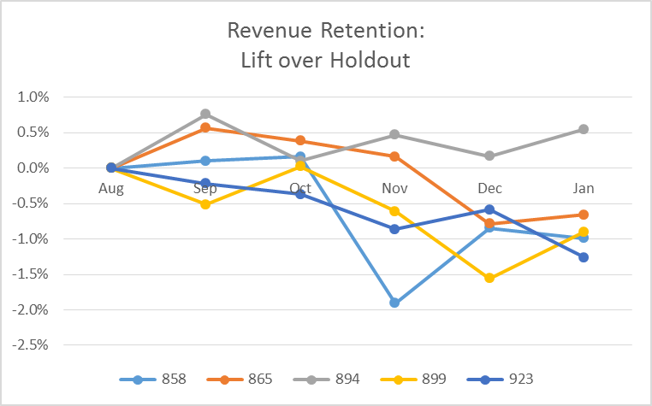
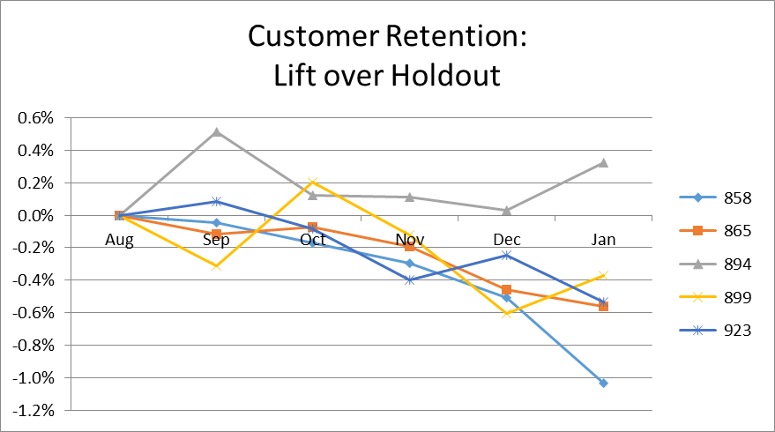
InfoPro Division Impacts
Only 894 (MN) is sowing positive revenue and customer lift. In this division, revenue is 0.5% higher than holdout as of Jan.
All other InfoPro companies are showing slightly negative lift
858 – Arkansas
865 – New Jersey
894 – Minnesota
899 – Minnesota
923 – Minnesota

Slide 10
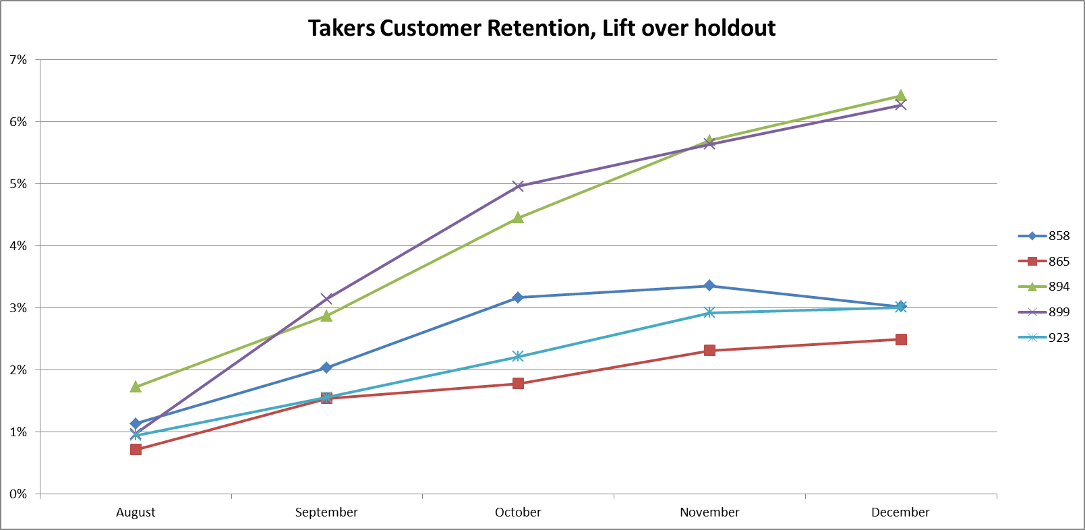
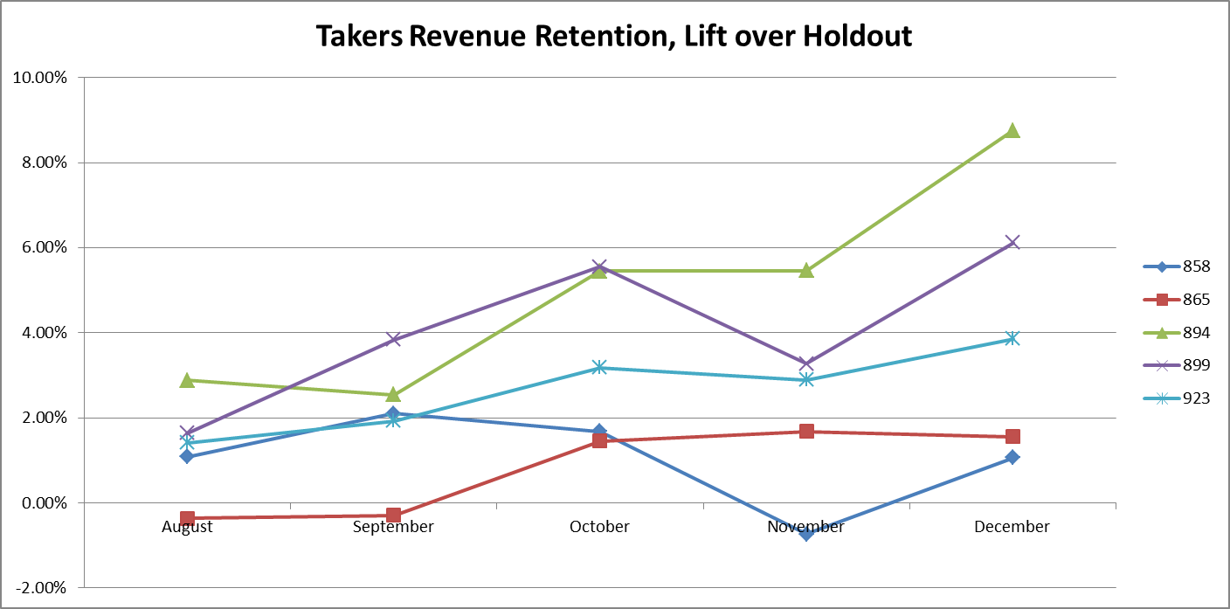
InfoPro Division Impact
Impacts are positive for takers
894 and 899 show the strongest lift for both revenue and customer retention
Positive taker lift and negative non-taker lift indicates selection bias rather than causality
858 – Arkansas
865 – New Jersey
894 – Minnesota
899 – Minnesota
923 – Minnesota

Slide 11
Conclusion
More aggressive offer had better take rate than less aggressive offer (~1%)
Offer was most appealing to newer customers
No significant customer or revenue lift observed across groups
Takers outperformed the holdout
Non-takers underperformed the holdout
Combined treated group underperformed HO
Strong selection bias observed:
Customers least likely to leave were most likely to sign renewal: no compelling evidence that the offer changed overall behavior
Newer customers, middle-aged customers, and more profitable customers performed better than other segments
Division 894 outperformed other divisions

Slide 12
Base statistics
Customers Mailed | 4 % Offer | 10 % Offer | Holdout | Grand Total
858 (Little Rock, AR) | 3,146 | 1,900 | 1,244 | 6,290
865 (New Jersey) | 4,195 | 2,571 | 1,691 | 8,457
894 (Minnesota) | 2,679 | 1,556 | 1,047 | 5,282
899 (Minnesota) | 2,142 | 1,233 | 832 | 4,207
923 (Minnesota) | 2,701 | 1,644 | 1,066 | 5,411
Grand Total | 14,863 | 8,904 | 5,880 | 29,647
Takers | 4 % Offer | 10 % Offer | HO | Grand Total
858 (Little Rock, AR) | 296 (9.41%) | 147 (7.74%) |  | 443 (7.04%)
865 (New Jersey) | 336 (8.01%) | 132 (5.13%) |  | 468 (5.53%)
894 (Minnesota) | 267 (9.97%) | 136 (8.74%) |  | 403 (7.63%)
899 (Minnesota) | 219 (10.22%) | 131 (10.62%) |  | 350 (8.32%)
923 (Minnesota) | 274 (10.14%) | 137 (8.33%) |  | 411 (7.6%)
Grand Total | 1392 (9.37%) | 683 (7.67%) |  | 2075 (7%)

